Slide 1


Spotify recommendation system
Mateusz Kielan(2774206), Szymon Czternasty(2774641), Jan Burakowski(2764440), IJsbrand de Meijere (267900)

Slide 2
Task Division
Problem one – Jan Burakowski
Problem two – Mateusz Kielan
Problem three – Szymon Czternasty
Presentation – IJsbrand de Meijere
Report – IJsbrand de Meijere
Notes:
INTRODUCTION
strategy
divide conquer
sorting the list
bubble sort
Searching the data
linear search
Three fases
Exercise one – Individual choice
Exercise two – Genres
Exercise three – Shifts (moods)

Slide 3
INTRODUCTION
IDEA
TASKS
STRATEGY
THREE PHASES
Notes:
INTRODUCTION
strategy
divide conquer
sorting the list
bubble sort
Searching the data
linear search
Three fases
Exercise one – Individual choice
Exercise two – Genres
Exercise three – Shifts (moods)

Slide 4
IDEA
DYNAMIC SYSTEM
RECOMMENDATION
LISTENING EXPERIENCE
Notes:
EX3

Slide 5
Exercise one: Individual choice
STRATEGY:
PROBLEMS ENCOUNTERED:
FLOWCHART
SOLUTION
Notes:
EX1

Slide 6
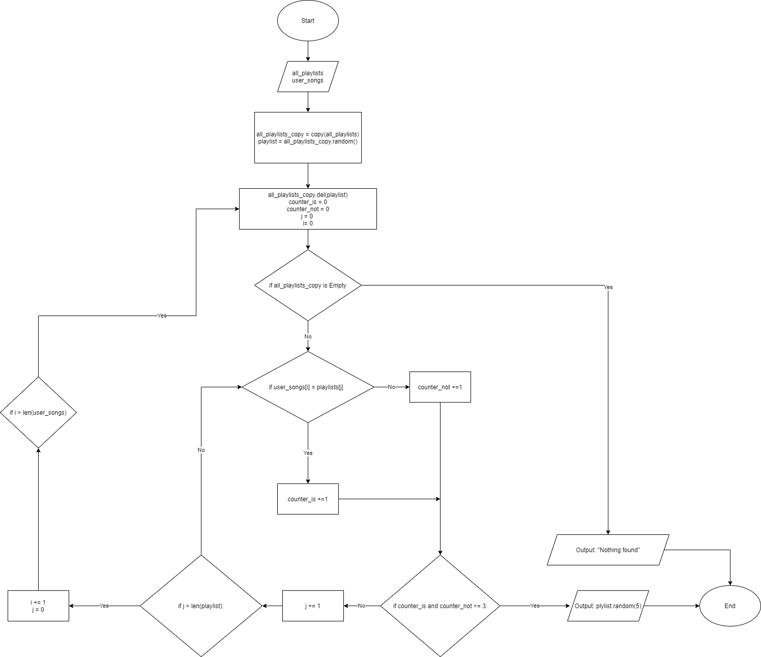
Notes:
EX1

Slide 7
Exercise two: Genre
STRATEGY
PROBLEMS ENCOUNTERED
FLOWCHART
SOLUTION
Notes:
EX1

Slide 8
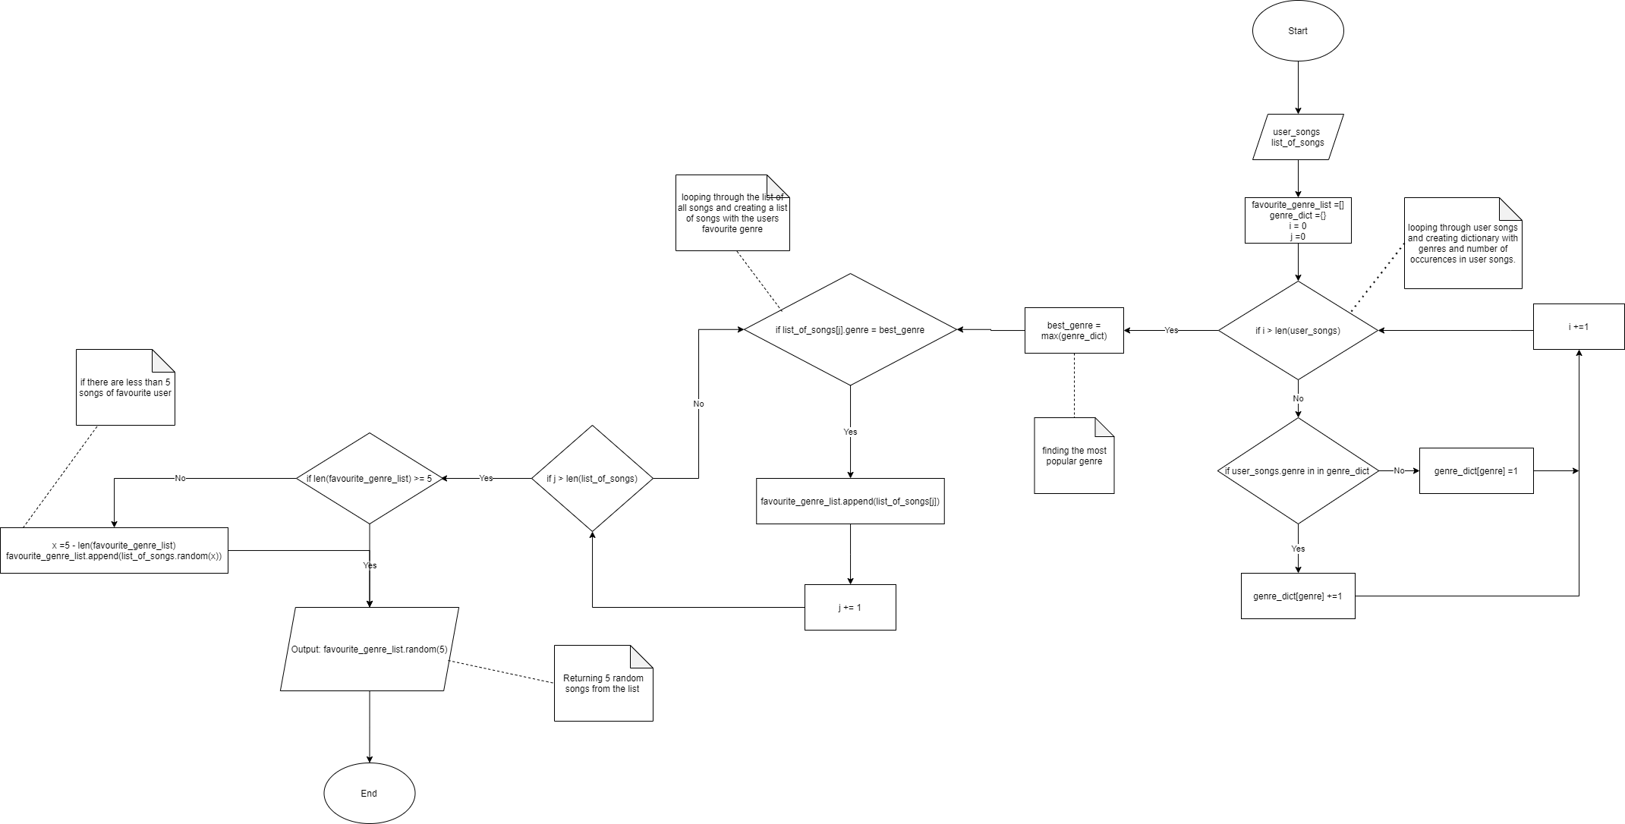
Notes:
EX2

Slide 9
Exercise three: Shifts
STRATEGY
PROBLEMS ENCOUNTERED
FLOWCHART
SOLUTION
Notes:
EX1

Slide 10
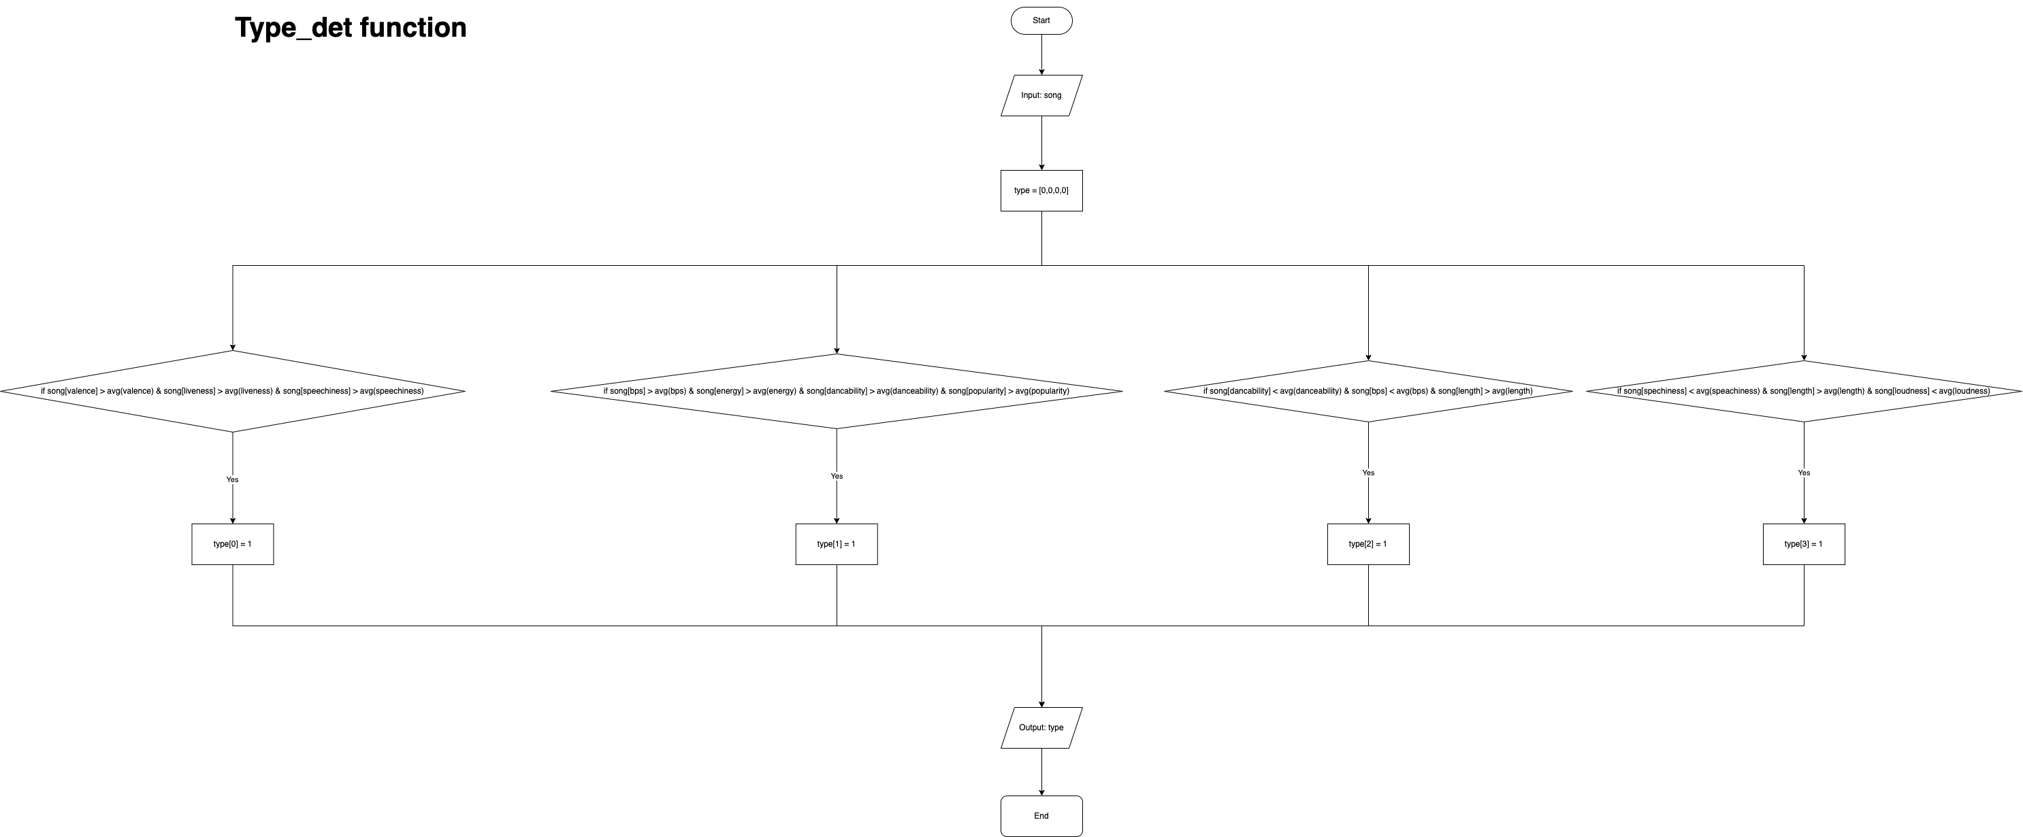
Notes:
EX3

Slide 11
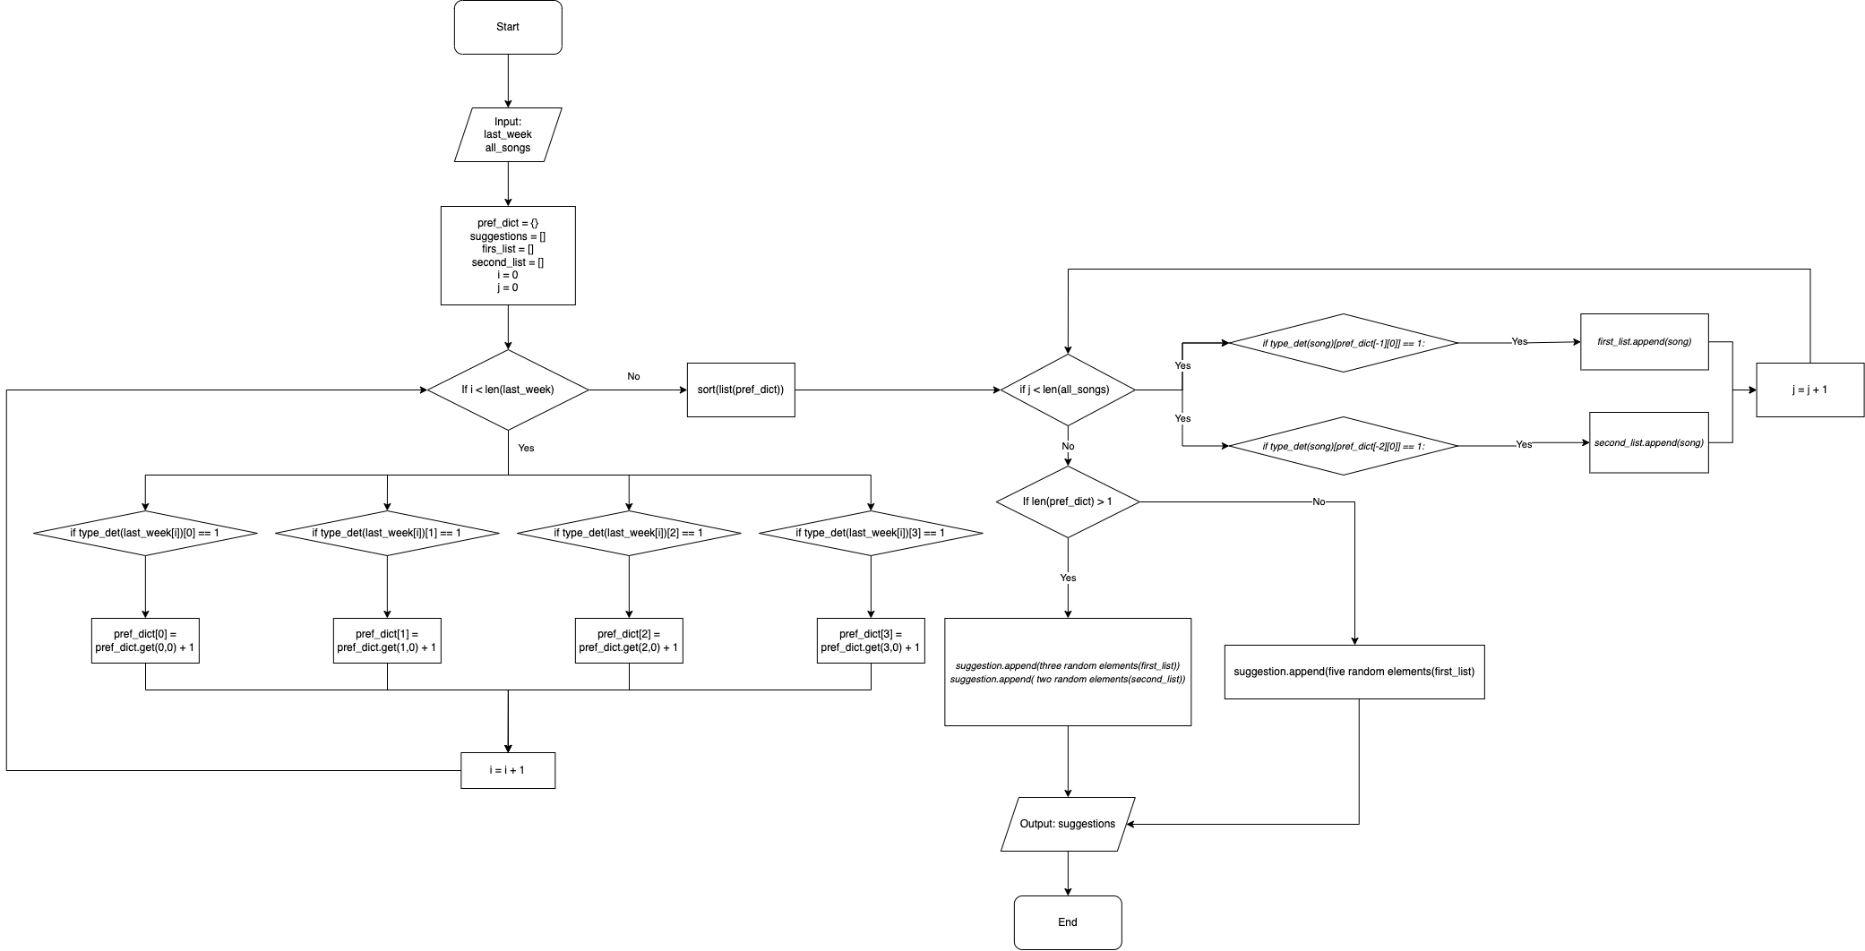
Notes:
EX3

Slide 12
MODEL
CODE STRUCTURE
PIPELINE
DATASET
OUTPUT
Notes:
EX3

Slide 13
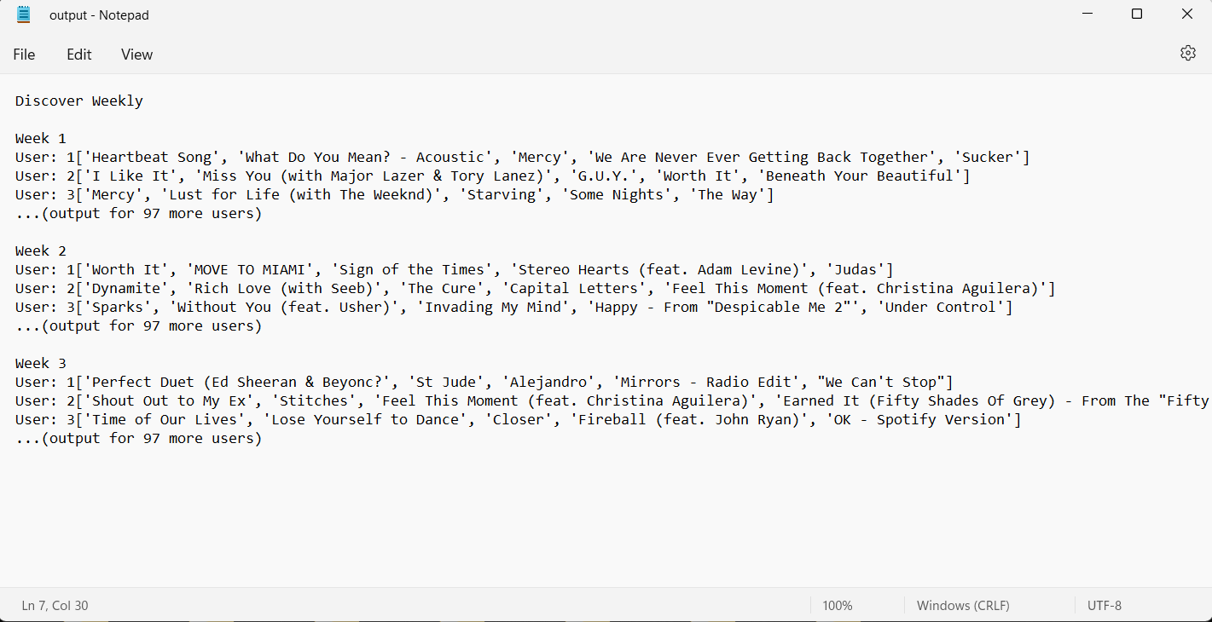
FINAL MODEL OUTPUT
Notes:
EX3

